Slide 1

INTERRUPT REQUEST BASED
ON HOSTING OF RFID D ATA
TO GOOGLE SHEET

Slide 2

2200040001- Bilivika
TEAM
MEMBERS:
2200040018- Venkat sai
2200040029- P.Venkat satvik

Slide 3

Components:
SOFT WARE:
Arduino Ide
Google spread sheet
HARD WARE:
ESP32
RFID SENSOR
JUMPER WIRES

Slide 4

INTRODUCTION:
An Interrupt Request based on RFID is a
method where a device pauses its current task
to respond to a signal from an RFID tag. This
allows for real-time interaction with RFID-
enabled objects, like inventory tracking or
access control, enhancing efficiency and
automation.

Slide 5
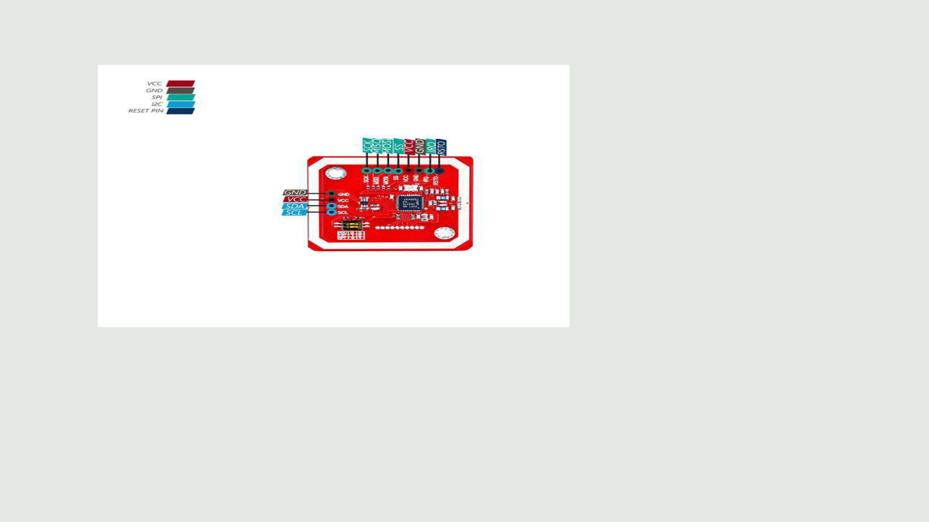
PIN DIAGRAM OF RFID PN532

Slide 6
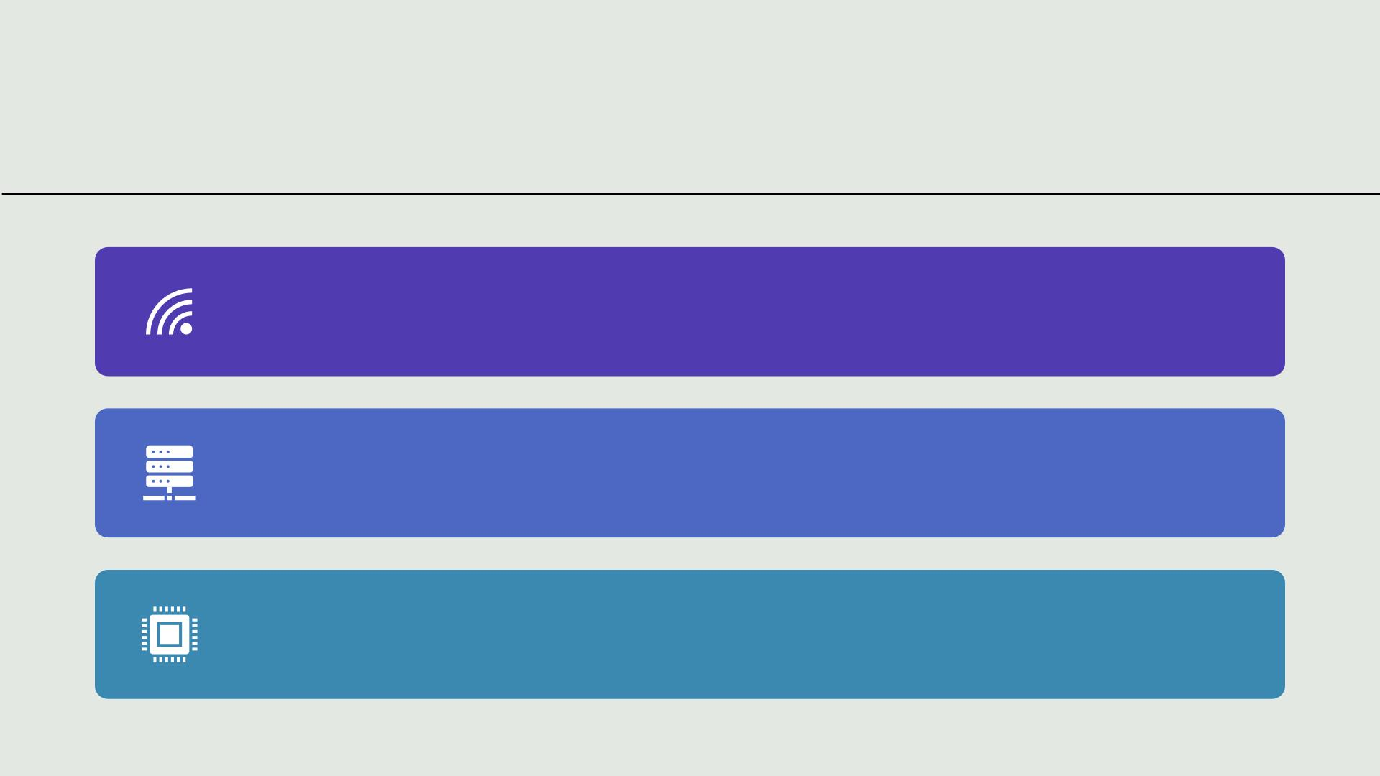
WORKING
The ESP32, a microcontroller with built-in Wi-Fi capabilities, is connected to an RFID reader.
When the RFID reader detects a tag, it sends an interrupt signal to the ESP32, indicating that new
data is available. The ESP32 then pauses its current task and retrieves the data from the RFID tag.
Once the data is obtained, the ESP32 uses its Wi-Fi connection to communicate with the Google
Sheets API or a third-party service like IFTTT or Zapier. It sends the RFID data to a designated
Google Spreadsheet in real-time.
This process allows for the seamless integration of RFID technology with Google Sheets, enabling
automated data transfer and tracking. It's a convenient way to monitor events, inventory, or other
information captured by RFID tags directly within a Google Spreadsheet.

Slide 7
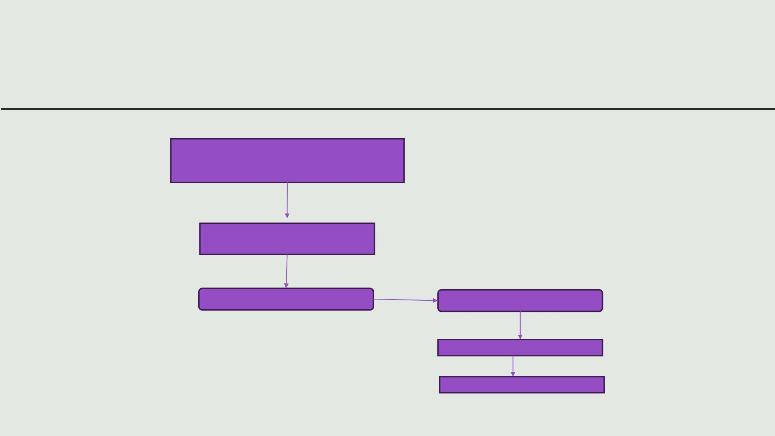
BLOCK DIAGRAM:
RFID TAG
RFID READER
ESP32
WIFI CONNECTION
Google sheet API
Google sheet

Slide 8
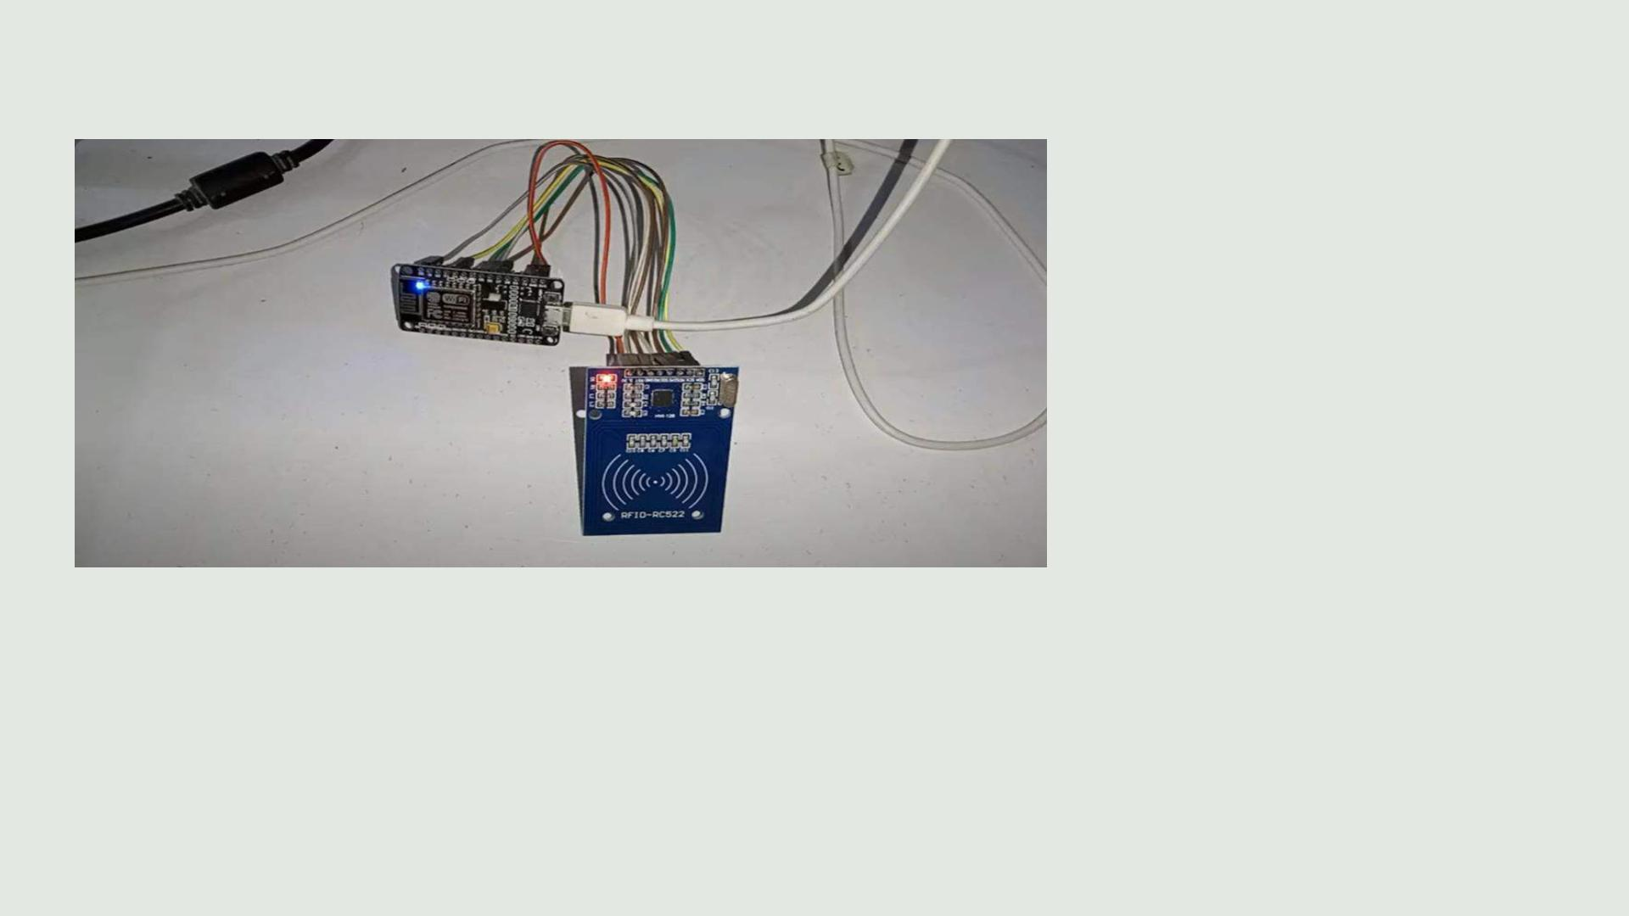
Connection diagram:

Slide 9
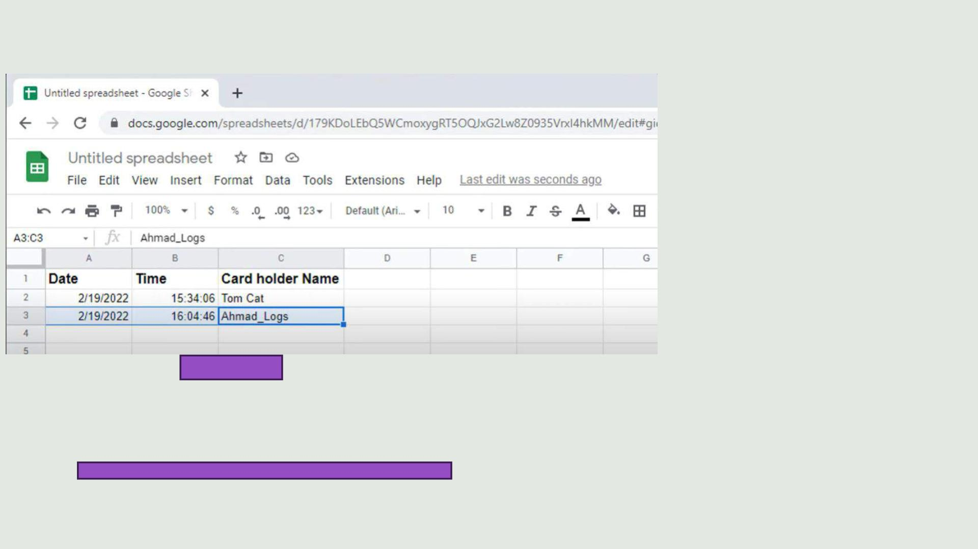
Google sheet data

Slide 10
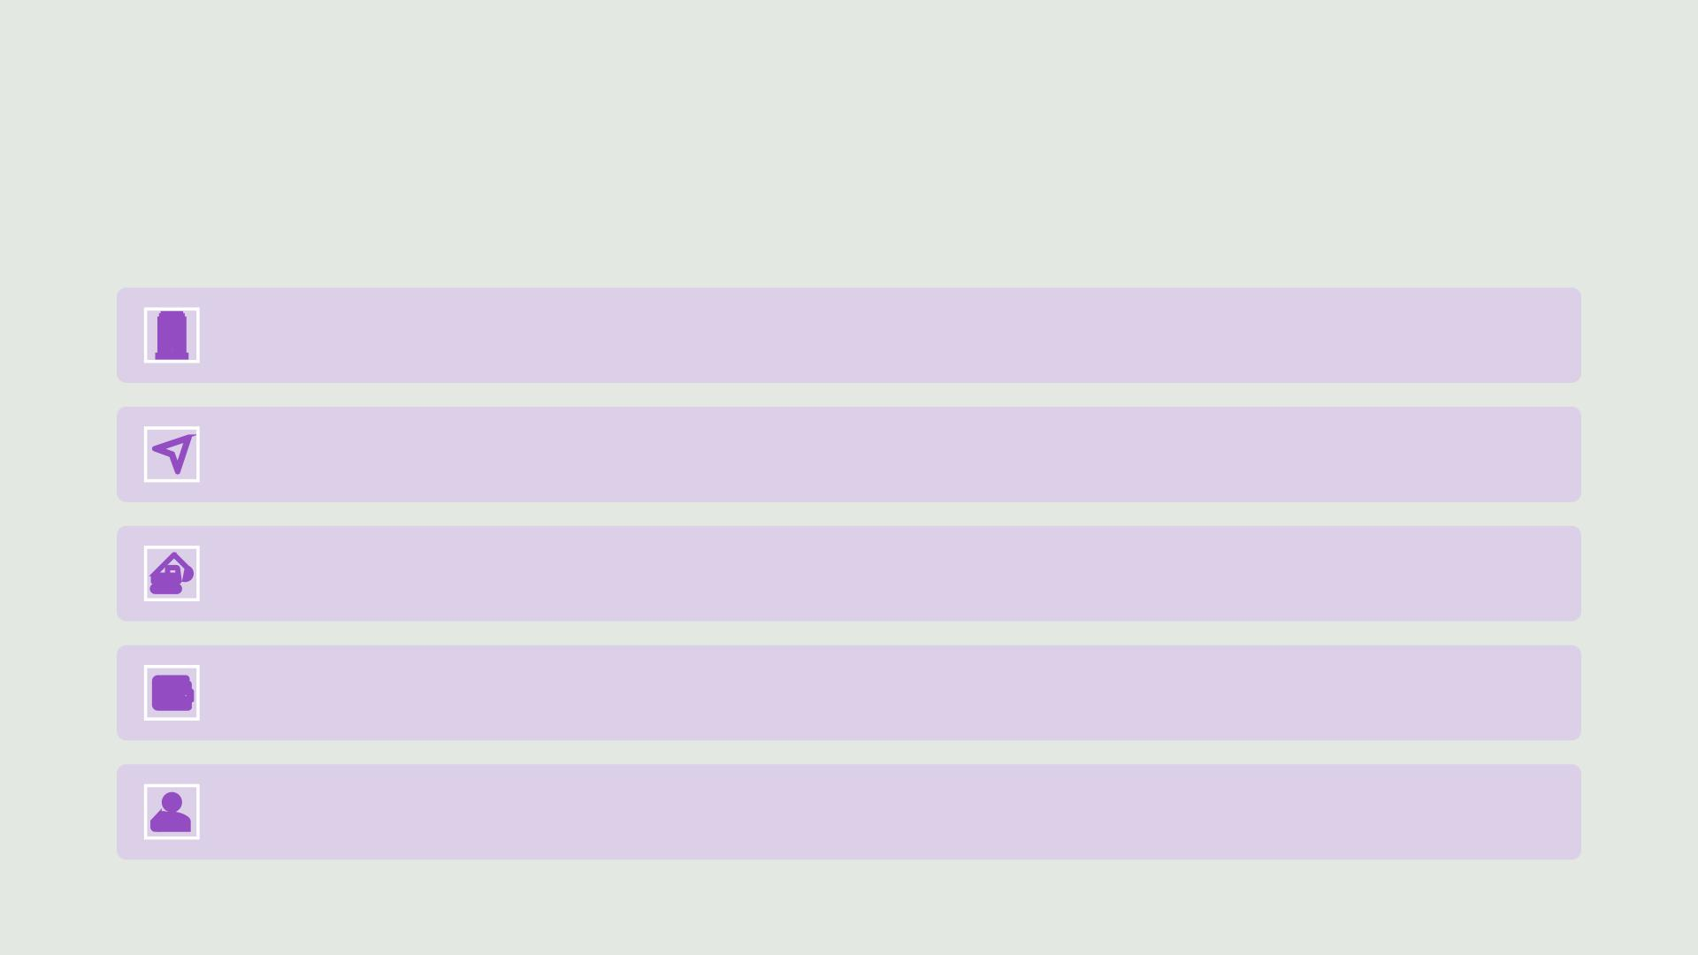
Applications:
Access control for buildings and offices.
Tracking inventory in retail stores.
Identifying and managing assets like equipment and vehicles.
Contactless payments with RFID-enabled cards or mobile wallets.
Monitoring livestock or pets for identification and health tracking.

Slide 11

OUTPUT VIDEO LINK
https://youtu.be/Yz_3MBK69oQ

Slide 12


Slide 13

Interrupt request based audio

Slide 14
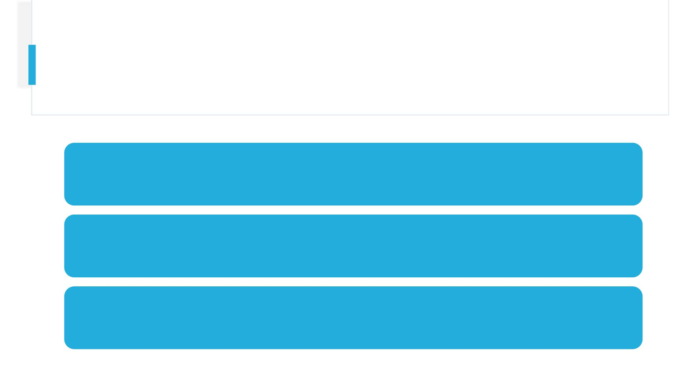
Team members:
2200040001-Bilvika
2200040018- Venkat sai
2200040029-P. Venkat satvik

Slide 15
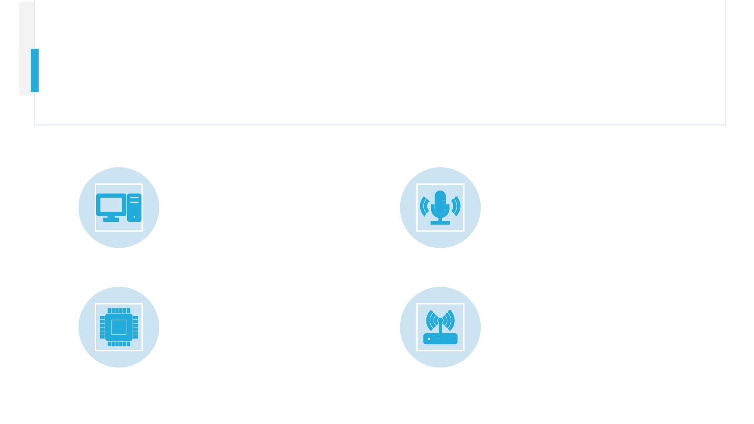
COMPONENTS:
Esp32, connecting
wires,i2s microphone
HARDWARE:
SOFTWARE:
Arduino IDE

Slide 16
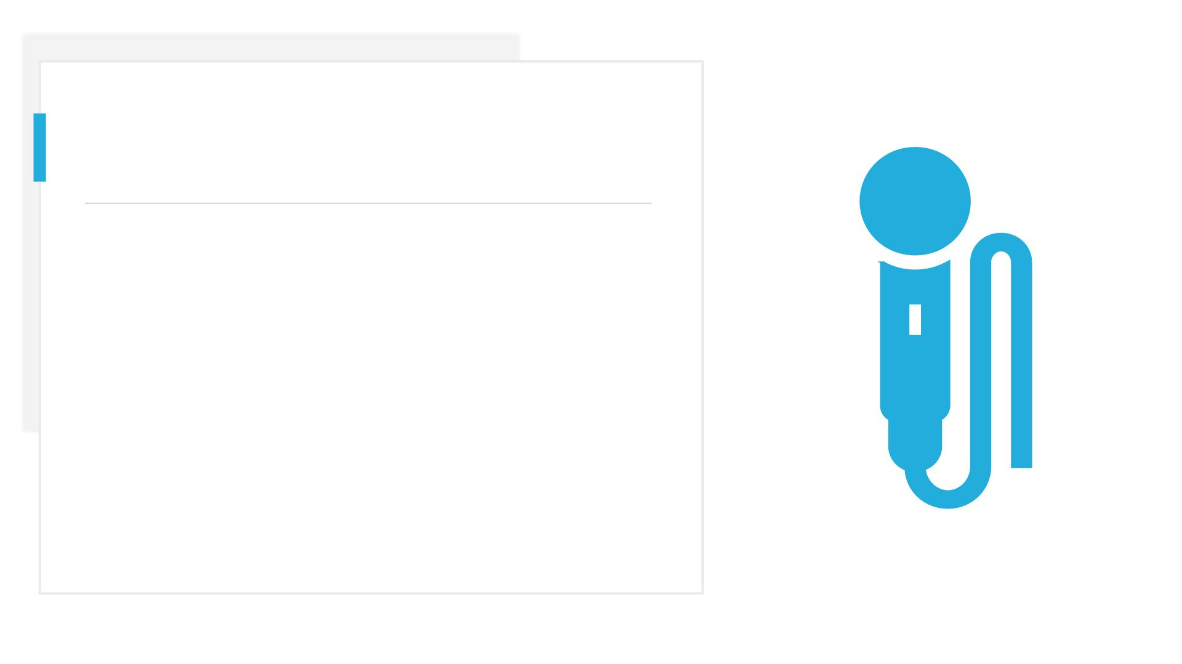
INTRODUCTION:
The ESP32, a versatile microcontroller, interfaces with an I2S
amplifier and microphone to enable audio-related projects. It
enables communication between the ESP32 and the I2S
amplifier, which boosts sound signals. The microphone
captures audio input, which is then processed by the ESP32
and sent to the amplifier for playback through speakers.

Slide 17
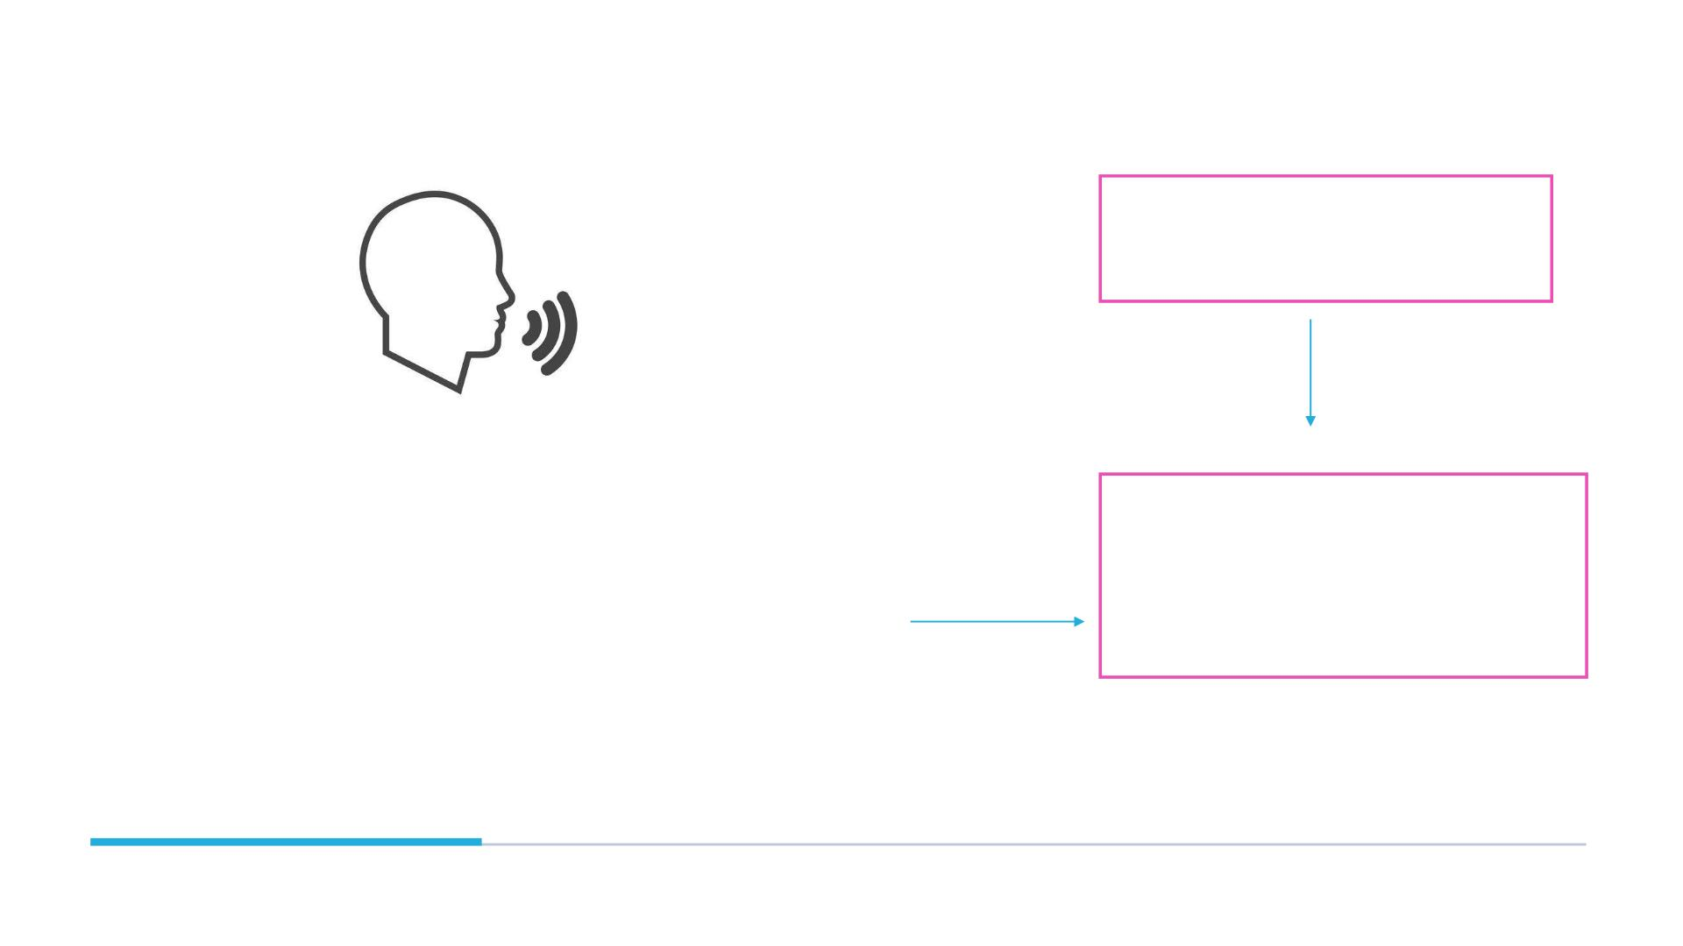
ESP-32
BLOCK
DIAGRAM:
I2S MICROPHONE

Slide 18
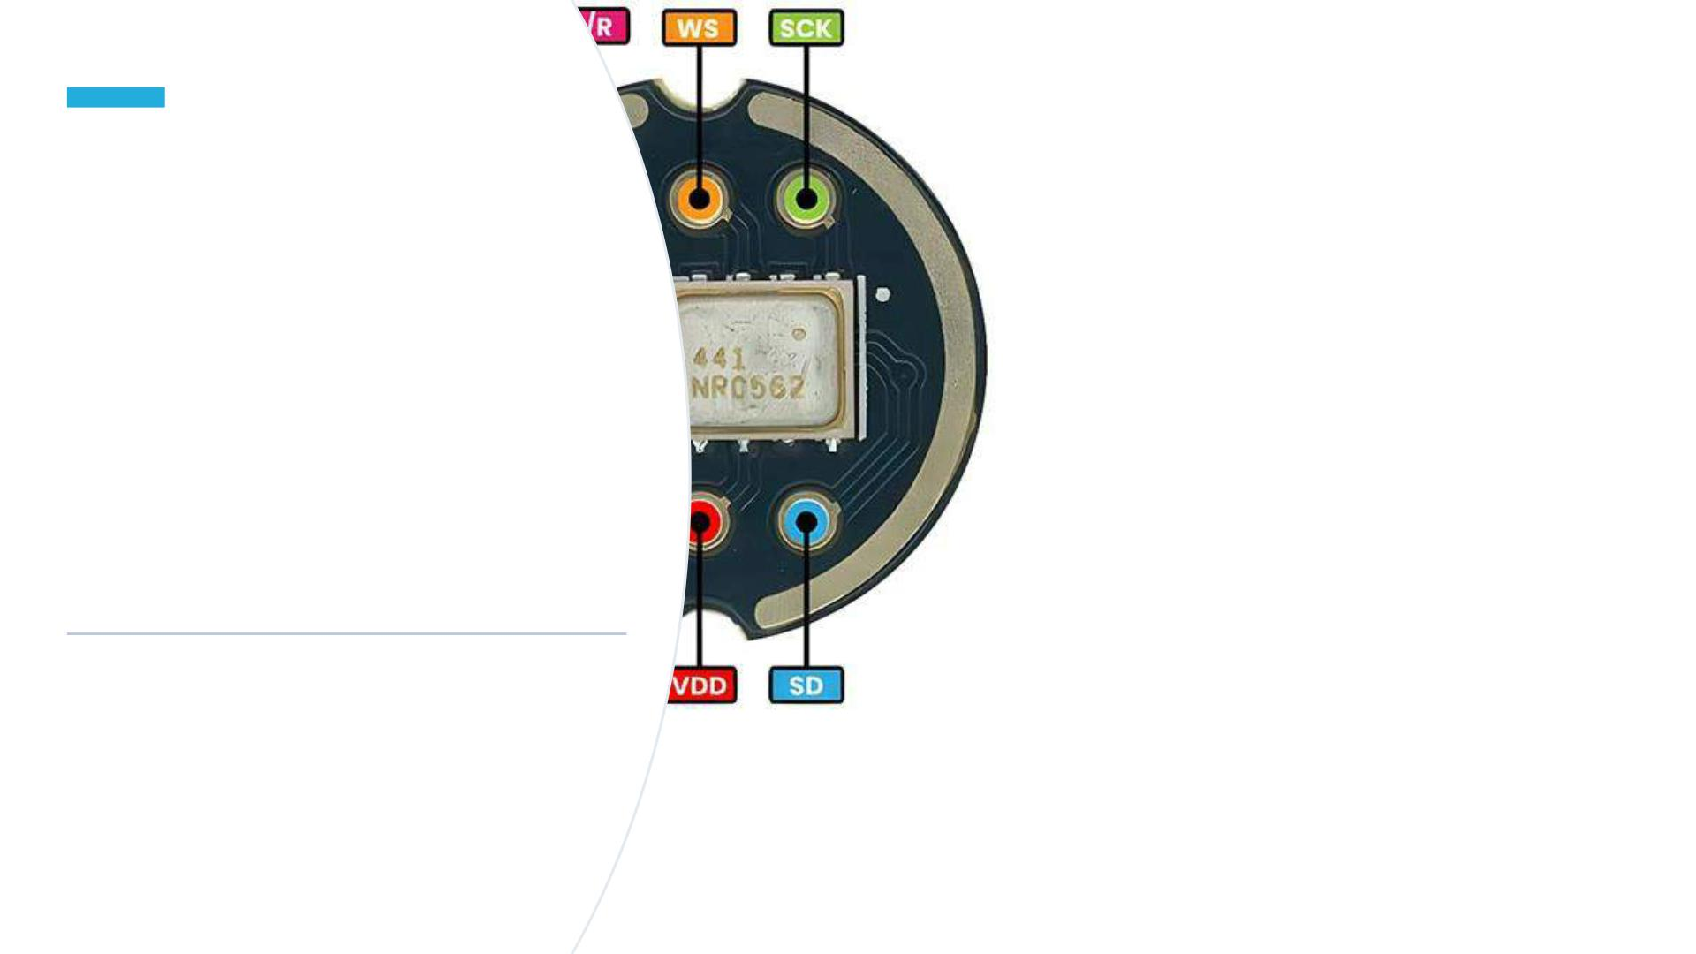
I2S
MICROPHONE
PINOUT:

Slide 19

WORKING
1. Microphone Input: The microphone captures sound signals (voice, music, etc.) and converts them into electrical signals.
2. ESP32 Processing: The ESP32 microcontroller processes the electrical signals received from the microphone. It can
perform various tasks such as filtering, amplification, or digital signal processing (DSP) on the audio data.
3. I2S Communication: The ESP32 communicates with the I2S amplifier using the I2S (Inter-IC Sound) protocol. This protocol
is specifically designed for transferring digital audio data between integrated circuits.
4. Amplification: The I2S amplifier receives the processed audio data from the ESP32 and amplifies it. This amplified signal is
then sent to the speakers or headphones connected to the amplifier.
5. Audio Output: Finally, the amplified audio signal is outputted through the speakers, allowing you to hear the sound
captured by the microphone.

Slide 20
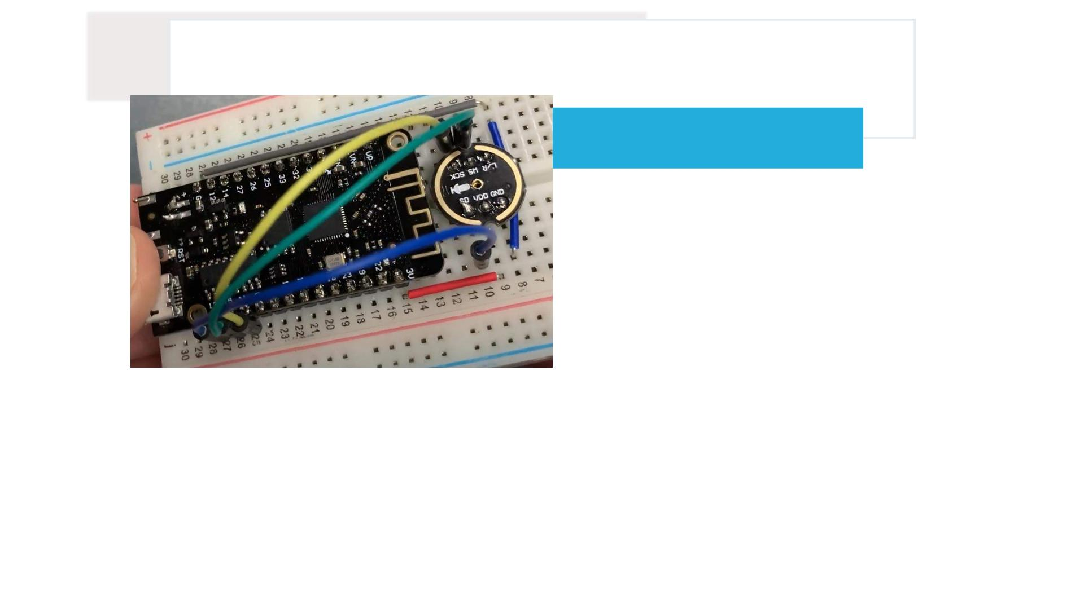
CONNECTION DIAGRAM:

Slide 21
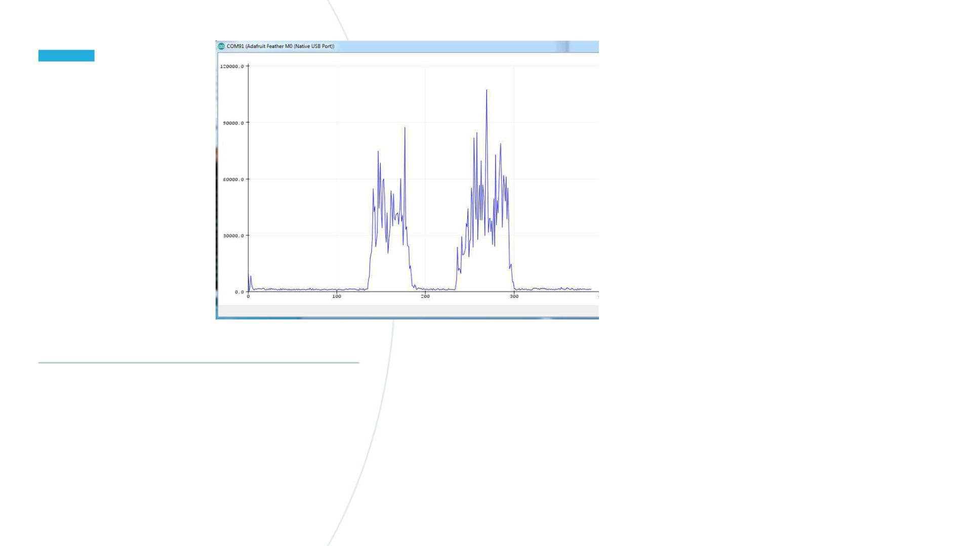
SERIAL
PLOT TER
GRAPH

Slide 22

APPLICATIONS:
1.Voice-controlled home automation using microphone input and speaker
output.
2.Real-time sound-reactive LED displays driven by ESP32 processing.
3.Portable music players with microphone input for recording and playback.
4.Environmental monitoring systems detecting ambient noise levels or specific
sounds.
5.Assistive technologies like voice-controlled communication devices or
personalized audio feedback systems.

Slide 23

OUTPUT VIDEO LINK
• https://youtu.be/LpxdTHYjFcA

Slide 24


Slide 25

BLUETOOTH HOME AUTOMATION

Slide 26
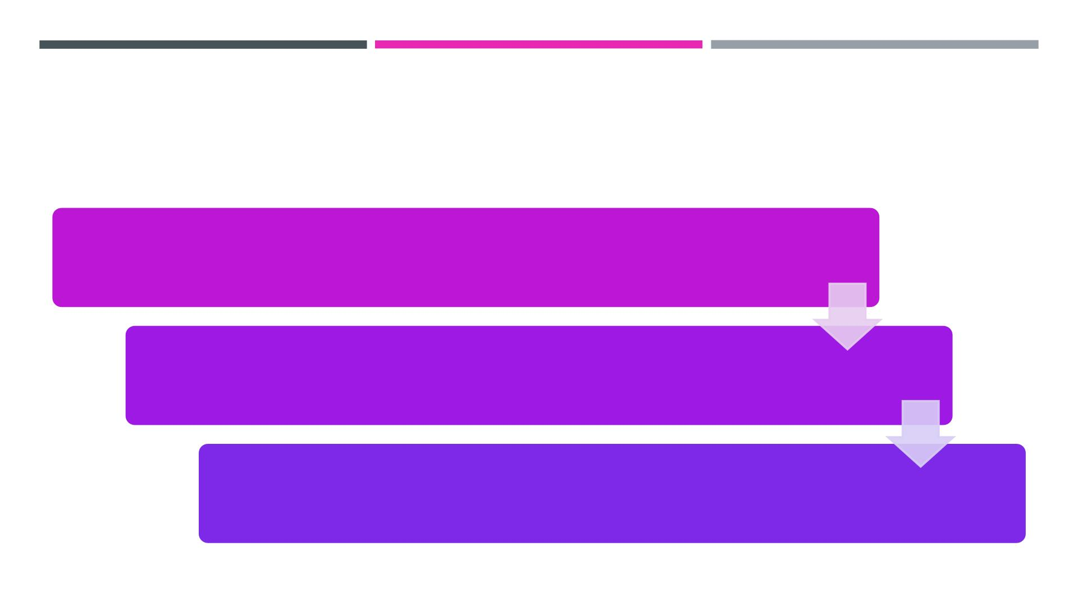
TEAM MEMBERS
2200040001 Bilvika
2200040018 Venkat sai
2200040029 p.Venkat satvik

Slide 27
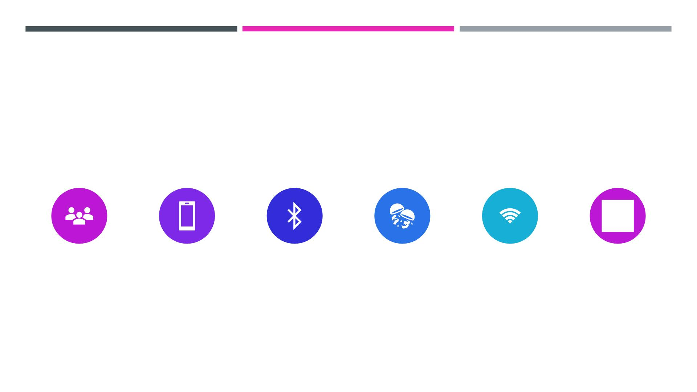
COMPONENTS REQURIED
ESP32 DEVELOPMENT
BOARD
• ANDROID MOBILE
• SERIAL BLUETOOTH
TERMINAL ANDROID
APP
• BREADBOARD
• CONNECTING
POTENTIOMETER
PHONE
WIRES

Slide 28

"ESP32's Bluetooth automation streamlines LED control,
enabling effortless on/off switching via smartphone
convenience to your lighting. With reliable Bluetooth
connectivity, manage your lights from anywhere with
ease.
INTRODUCTION:

Slide 29
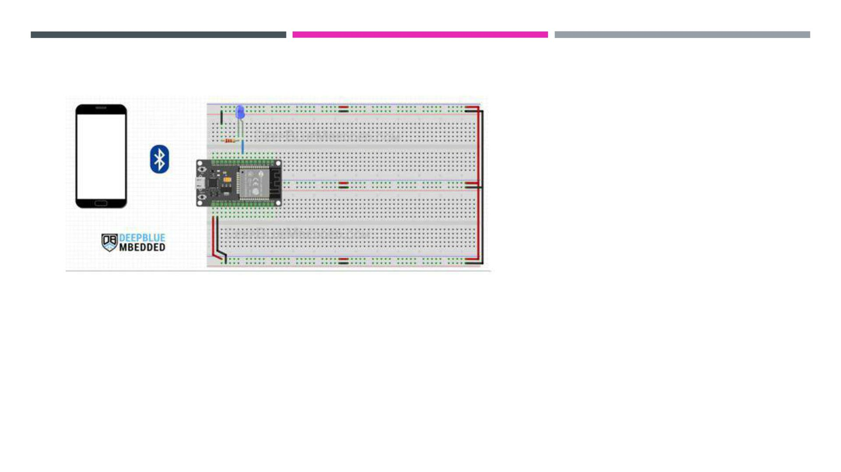
CONNECTION DIAGRAM:

Slide 30

CODE
#include "BluetoothSerial.h"
#if !defined(CONFIG_BT_ENABLED) || !defined(CONFIG_BLUEDROID_ENABLED)
#error Bluetooth is not enabled! Please run `make menuconfig` to and enable it
#endif
#if !defined(CONFIG_BT_SPP_ENABLED)
#error Serial Bluetooth not available or not enabled. It is only available for the ESP32
chip.
#endif
// LED GPIO Pin Definition
#define LED_GPIO 25
// Potentiometer Analog Channel GPIO Pin
#define AN_Pot 35
// Bluetooth Serial Object (Handle)
BluetoothSerial SerialBT;
// Timer0 configuration Handle
hw_timer_t *Timer0_Cfg = NULL;

Slide 31
// ESP32 Bluetooth (Slave) Device Information
const char *pin = "1234"; // Change this to more secure PIN.
String device_name = "ESP32-BT-Slave";
// Bluetooth Received Byte & Message Buffer Array
String RxBuffer = "";
char RxByte;
// Timer0 ISR Handler Function (Configured To Execute Every 100ms)
void IRAM_ATTR Timer0_ISR()
{
// Read The Potentiometer ADC Channel & Send Raw Data Over Bluetooth
SerialBT.println(analogRead(AN_Pot));
}
void setup() {
pinMode(LED_GPIO, OUTPUT);
Serial.begin(115200);
SerialBT.begin(device_name); //Bluetooth device name
Serial.printf("The device with name \"%s\" is started.\nNow you can pair it with
Bluetooth!\n", device_name.c_str());
SerialBT.setPin(pin);

Slide 32
Serial.println("Using PIN");
// Configure Timer0 Interrupt (Every 100mS)
Timer0_Cfg = timerBegin(0, 80, true);
timerAttachInterrupt(Timer0_Cfg, &Timer0_ISR, true);
timerAlarmWrite(Timer0_Cfg, 100000, true);
timerAlarmEnable(Timer0_Cfg);
}
void loop() {
// Read The Received Bytes & Add Them To Message (RxBuffer) Array
if (SerialBT.available()){
RxByte = SerialBT.read();
if (RxByte != '\n'){
RxBuffer += String(RxByte);
}
else{
RxBuffer = "";
}
Serial.write(RxByte);
}
// Check The Received Message & Update Output LED State
if (RxBuffer =="led_on"){

Slide 33
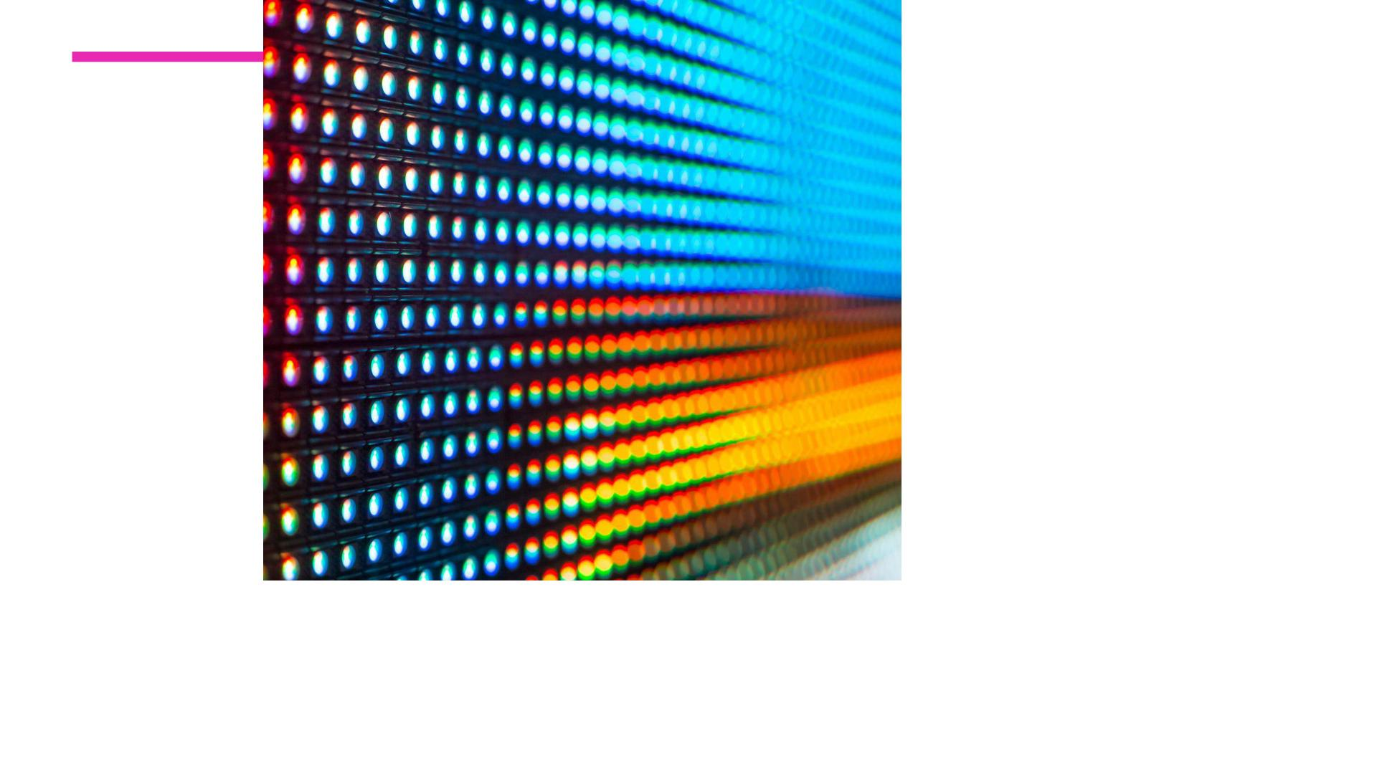
○ digitalWrite(LED_GPIO, HIGH);
○ }
○ else if (RxBuffer =="led_off"){
○ digitalWrite(LED_GPIO, LOW);
○ }
○ delay(25);
○}

Slide 34
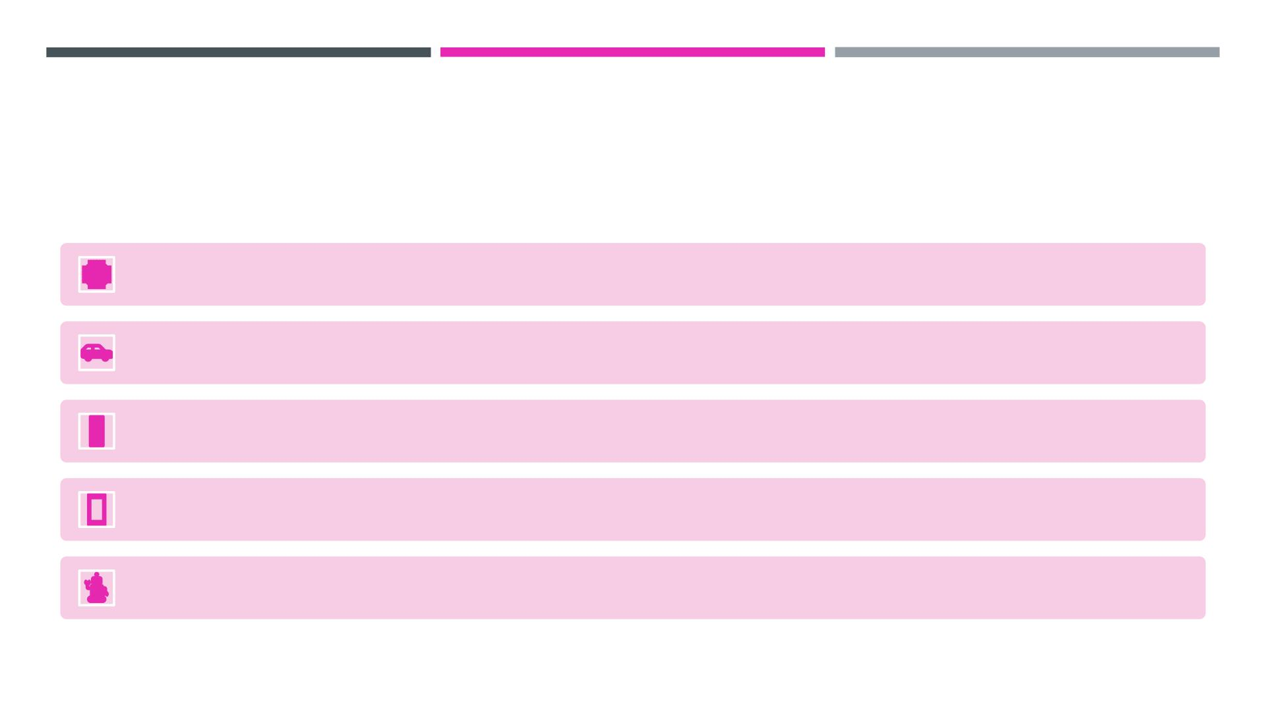
APPLICATIONS:
Home automation: Control lights, appliances, and thermostats wirelessly.
Automotive: Hands-free calling, music streaming, and vehicle diagnostics.
Healthcare: Remote monitoring of medical devices and patient data transfer.
Retail: Beacon technology for targeted marketing and seamless payments.
Industrial: Asset tracking, equipment monitoring, and process automation.

Slide 35

CONCLUSION
○ If we press led_on the led will
glow
○ If we press led_off the led will
glow
○ Based on this application home
automation has completed

Slide 36

OUTPUT VIDEO LINK
HTTPS://YOUTU.BE/HVZAIPD19ZE

Slide 37


Slide 38
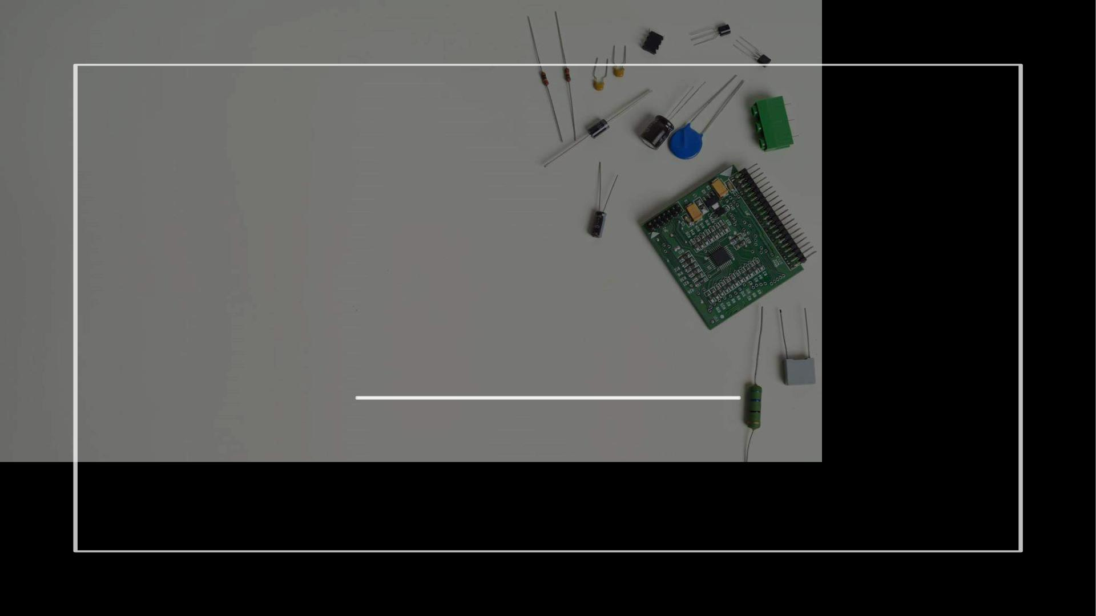
WIFI HOME AUTOMATION
USING ESP32

Slide 39
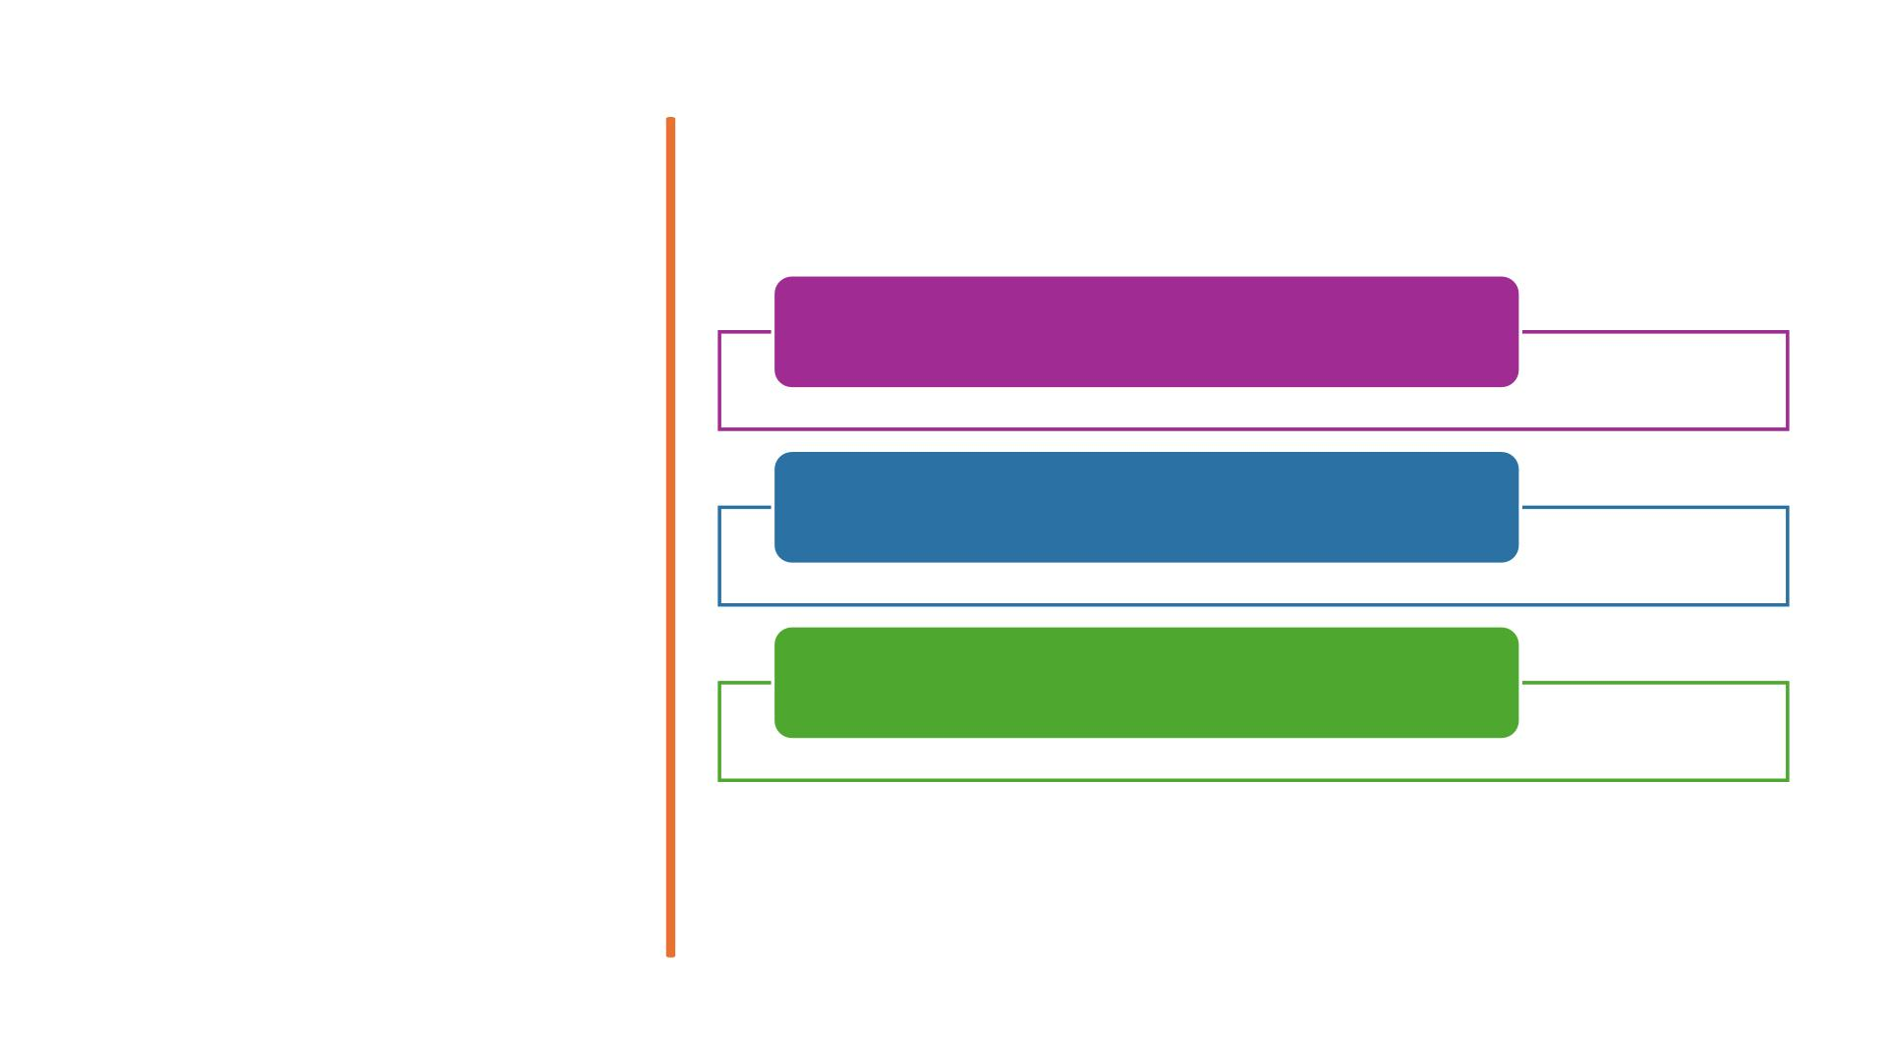
2200040001 BILVIKA
TEAM
MEMBERS
2200040018 VENKAT SAI
2200040029 P.VENKAT SATVIK

Slide 40
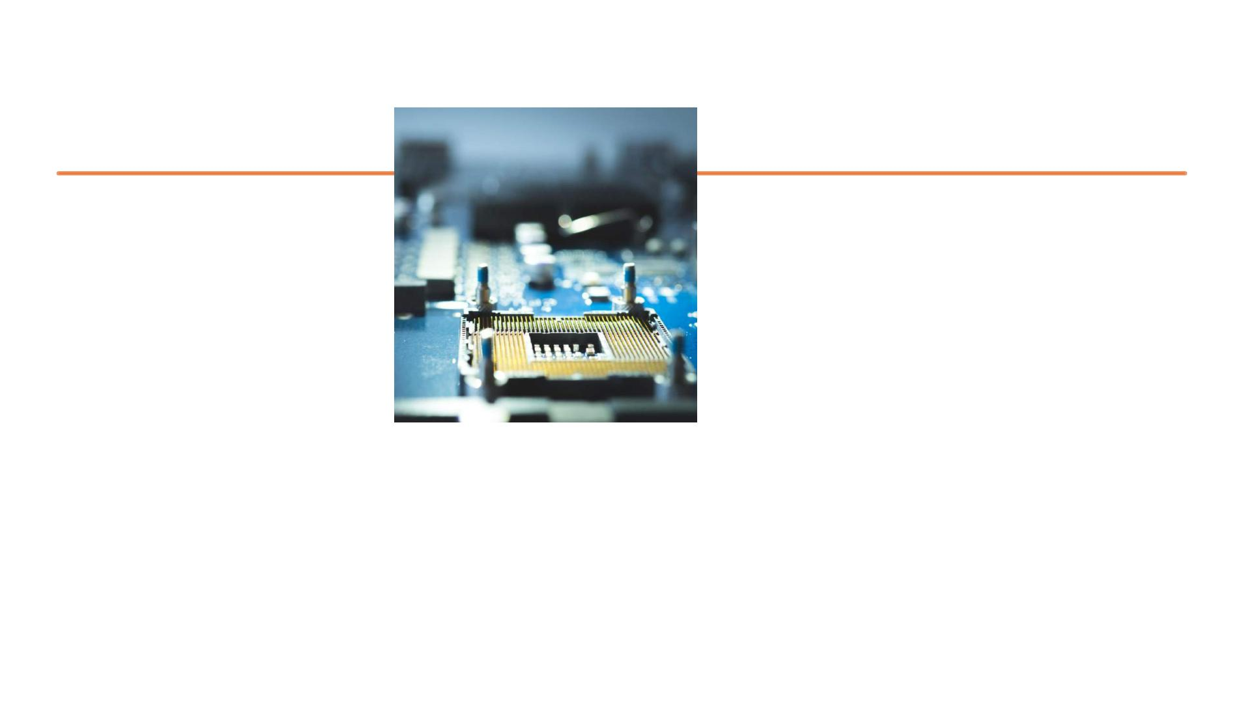
COMPONENTS REQUIRED
HARDWARE COMPONENTS:
ESP-32
• BREAD BOARD
• JUMPER WIRES
• LED
• RELAY MODULE
• SOFTWARE COMPONENTS
• ARDINO IDE
• BLINK APP

Slide 41

INTRODUCTION
• The ESP32 module relates to the Wi-Fi, then you can control
the home appliances from Blynk App and push-buttons. You
can control, monitor the real-time status of the relays from
anywhere in the world with the Blynk App.

Slide 42
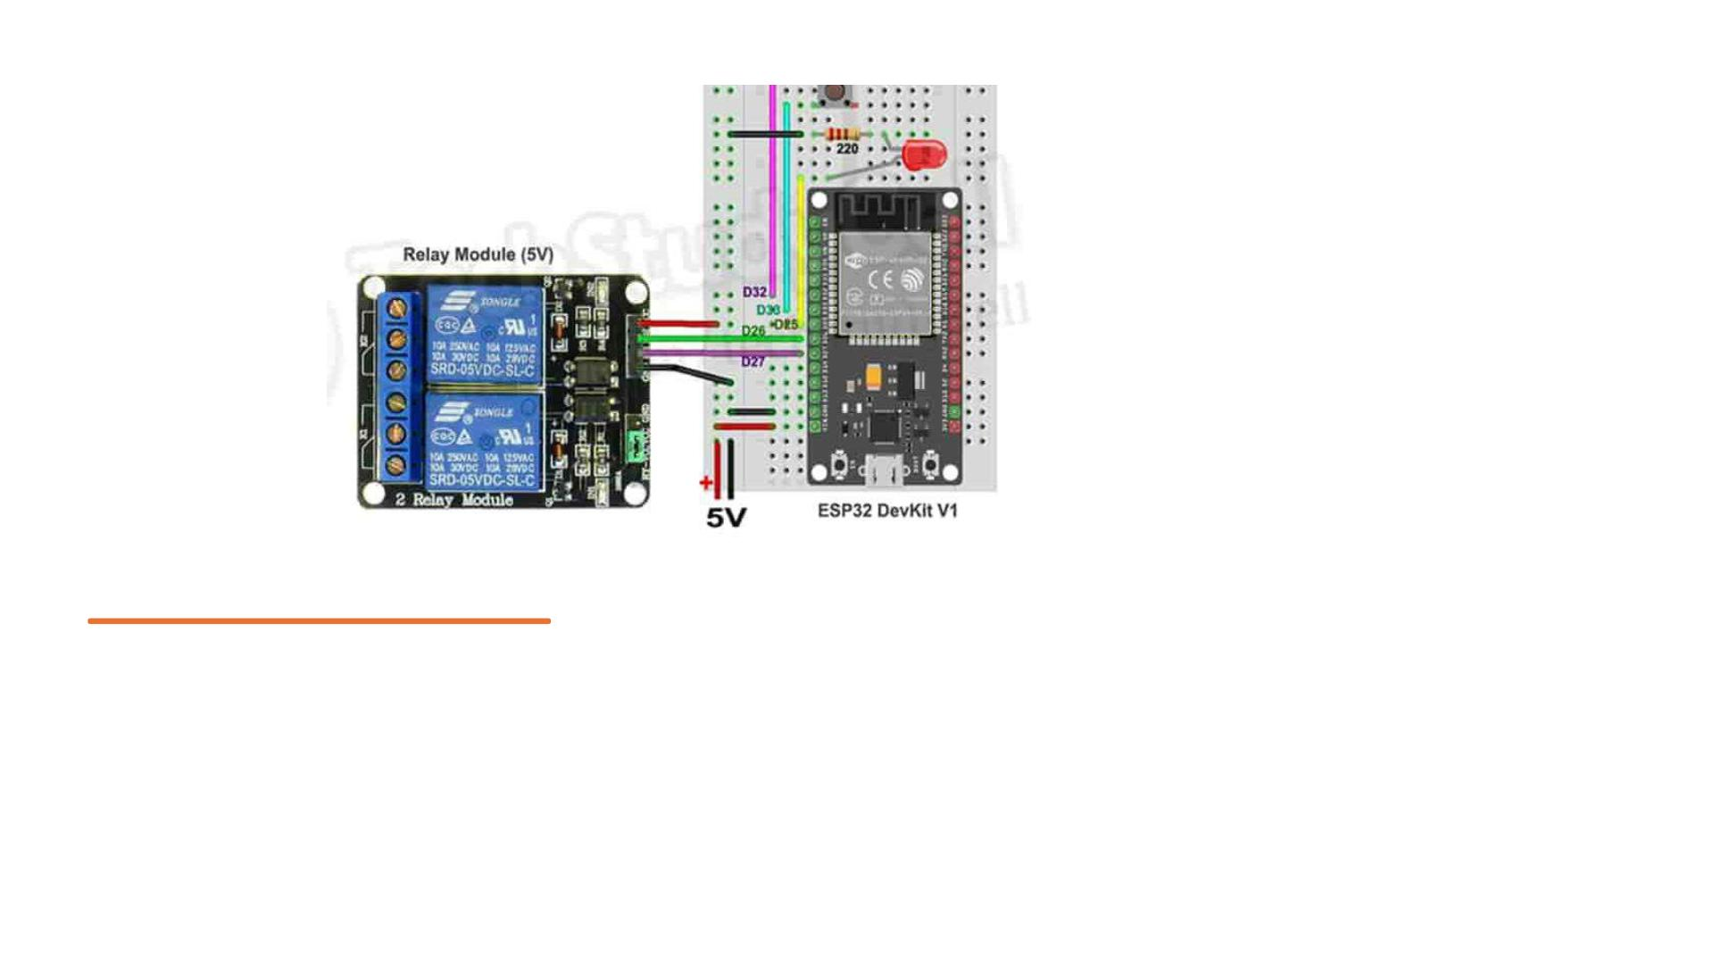
CIRCUIT
DIAGRAM

Slide 43
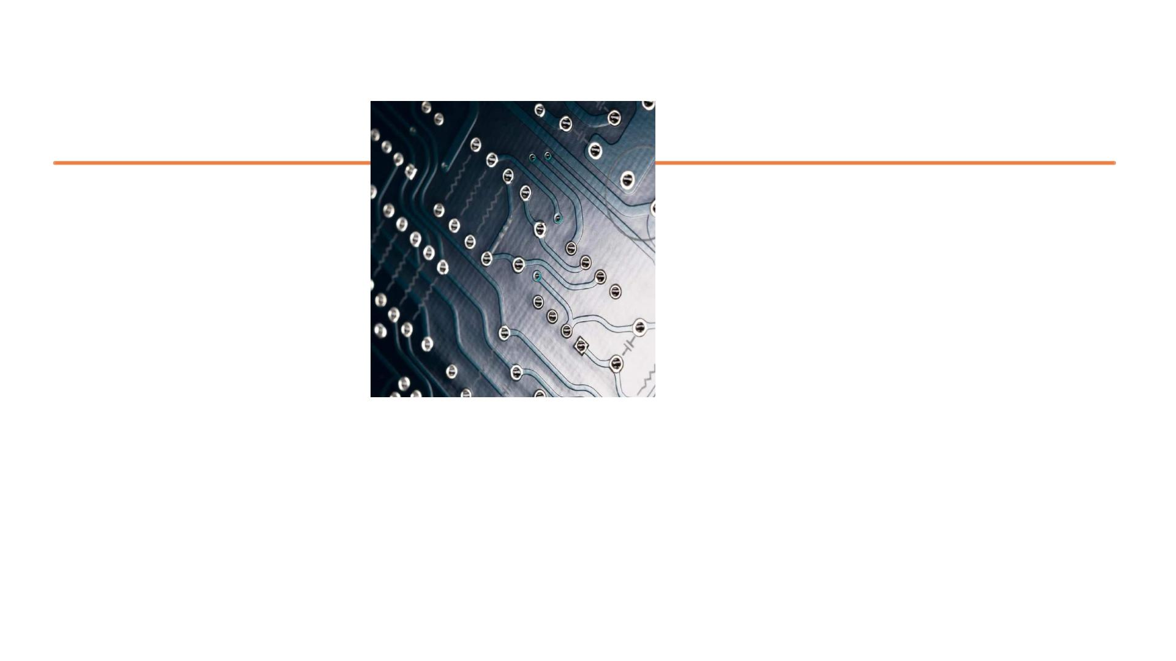
WORKING
• Here's a simplified description of how this circuit would work:
• 1. Apply power to the system.
• 2. If you want to turn on the first LED:
•
- Energize the coil of the first relay, which closes its contacts, allowing current to
flow through the LED connected to it, thus lighting up the first LED.
• 3. If you want to turn off the first LED:
- De-energize the coil of the first relay, which opens its contacts, cutting off the
•
current flow to the first LED, causing it to turn off.
• 4. Repeat the process for the second LED using the second relay.
• This setup allows you to control the state of the LEDs (on or off) by activating or
deactivating the corresponding relays. Typically, relays are controlled by some
external input signal, such as a switch, a microcontroller, or another electronic
circuit. By controlling these input signals, you can control the state of the LEDs as
desired.

Slide 44

APPLICATIONS:
1. Turn lights on or off remotely using a smartphone app or voice
commands.
2. Adjust heating or cooling systems based on preset schedules or
environmental conditions.
3.Monitor and control security cameras, alarms, and door locks for
added safety.
4.Optimize energy usage by automatically turning off appliances when
not in use.
5. Automate tasks like watering plants, feeding pets, or opening
curtains to make daily life easier.

Slide 45
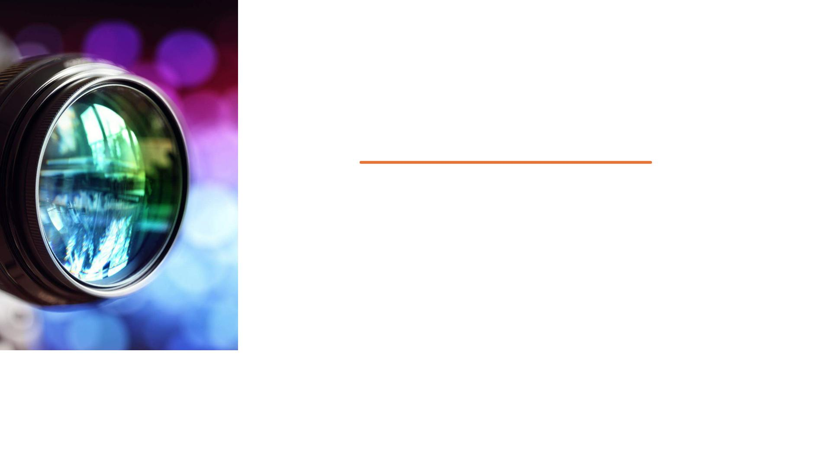
OUTPUT VIDEO LINK
https://youtube.com/shorts/luvf8UA2s0g?feature=sh
are

Slide 46


